Slide 1
Cloud Readiness Assessment – Cloud Accelerators and Inhibitors
Highlighted below are they key factors that determine whether an application is suitable for Cloud or not
Accelerators
Highlighted below are factors that would signify that workloads are Cloud suitable.
Inhibitors
Highlighted below are factors that would hinder the suitability of a workload for Cloud.
Dev/Test Environments – Sandbox environments can be easily scaled up or torn down on demand in the Cloud and are prime candidates for migration.
High Network Throughput Applications – Applications with high throughput requirements may see performance issues and latency if they are located away from their users.
Infrequently Accessed Storage Archives – It can be more cost effective to host large storage volumes that do not require frequent or immediate access.
Amount of data – When a large amount of data is involved then cloud computing is the cost efficient approach. Consumers need not invest in additional hardware for extra data storage
High volatility – Those applications which have a high degree of volatility are Cloud suitable as changes are easy and quick.
Degree of Integration– Applications with high degree of integration must be cloud- implemented due to its advantage of giving access to applications to multiple users from multiple devices
Heavily Integrated Applications – Applications that are heavily integrated will continue to require a high amount of communication or dependencies with their counterparts. In this case it is recommended that they remain together, be it in the Cloud or on premise.
Customization– If applications need a high degree of customization then, it is not entirely possible in the SaaS environment in cloud computing.
Data Sensitivity – In the Cloud, extremely sensitive information can prove to be an inhibitor as the exact location of data may or may not be known
Cloud Suitable
Less Cloud Suitable
Please note, inhibitors are not part of the ideal answer, and have only been included here for reference.

Slide 2
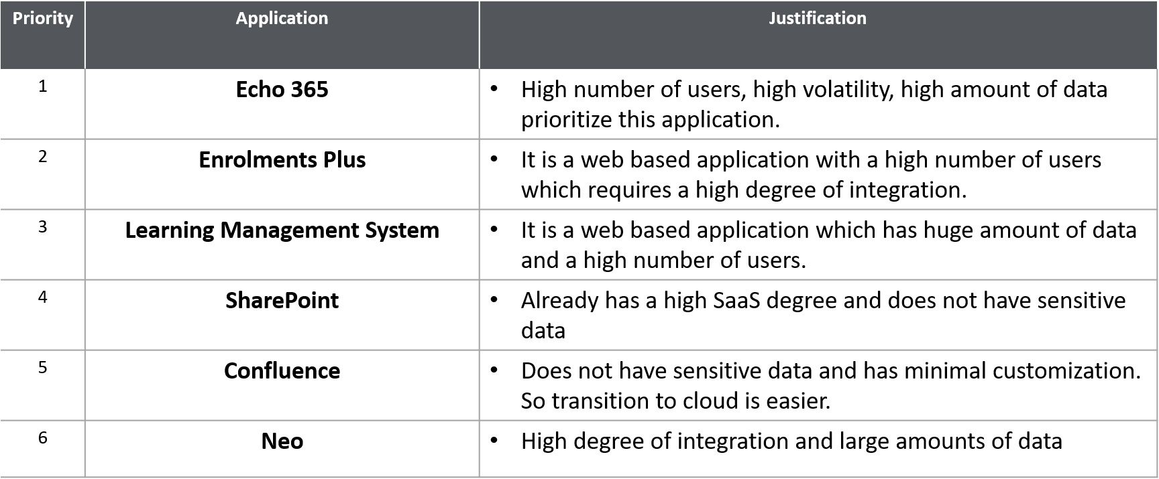
Cloud Readiness Assessment – Application Prioritisation
Highlighted below are the applications that should be prioritised for the Cloud Proof of Concept and a brief justification as to why

